Slide 1
100 living labs and lighthouses to lead the transition towards healthy soils by 2030
Sandra Heinzelmann
Unit F2 Research and Innovation – Soil Mission Secretariat
European Commission - DG Agriculture and Rural Development

Slide 2
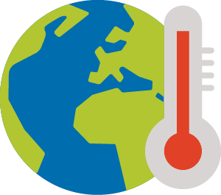
Missions: a new instrument under Horizon Europe to address major societal challenges
Adaptation to Climate Change
Cancer
Climate-neutral and Smart Cities
Restore our Ocean and Waters
Soil Deal for Europe
Mission Manager
DG AGRI

Slide 3
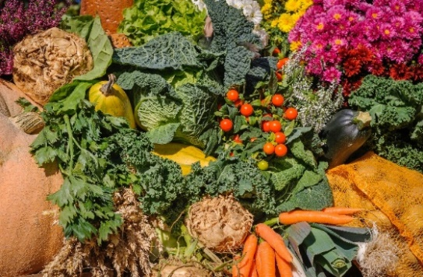
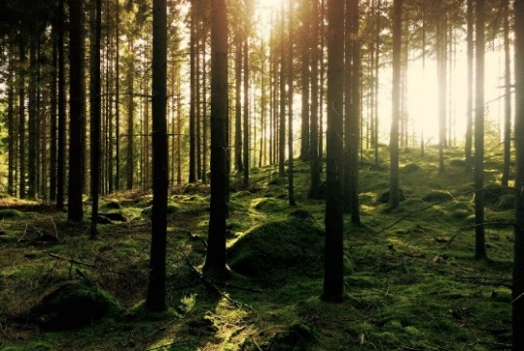
Why a mission on soil?
Healthy soils are the basis for nutritious and safe food.
Soils deliver other vital, interconnected ecosystem services:
hosting biodiversity,
nutrient cycling,
water regulation (incl. preventing droughts and floods),
climate mitigation and adaptation,
cultural services
Soil is a scarce, almost non-renewable resource: it takes hundreds of years to generate 1 cm of top soil.
Soils are threatened: about 60-70% of all soils in Europe are considered to be unhealthy due to current management practices, pollution, urbanisation and the effects of climate change

Slide 4
We need to act now!
Soils need our attention!
25% of land at High or Very High risk to desertification in Southern, Central and Eastern Europe in 2017
Cropland soils losing carbon at a rate of 0.5% per year; 50% of peatlands drained and losing carbon – this is contributing to the climate crisis
24% of land with unsustainable water erosion rates
2.8 million potentially contaminated sites posing major health risks
65-75% of agricultural soils with nutrient inputs at levels risking eutrophication of soils and water and affecting biodiversity
The costs associated with soil degradation in the EU exceed 50 billion € per year
The effects of climate change put further pressure on soils and accelerate land degradation!
Notes:
With this mission area, EU legislators are recognising the value of soils and the urgency to act.
Soils perform a range of vital functions (, e.g. provision of food, clean water, biodiversity and cultural services, nutrient cycling, climate regulation)
Land/soils are a scarce, non-renewable resource
Soils are at the center of major societal challenges (food security, loss of biodiversity, climate mitigation and adaptation)
Action on land/soils is critical to meet political commitments including the Sustainable Development Goals and the Green Deal.
As Annette has just outlined, there is a growing, promising portfolio of soil research projects. But this is just the beginning of increased efforts to overcome underspending for soil research in the past.
So, I hope that the future mission in the area of soil health and food will be a game changer for the soil research community, for school and research education, advisors, land managers and the wider public.

Slide 5
The Soil Deal Mission supports the Green Deal
Examples of soil relevant Green Deal targets
The Mission is part of
Farm to Fork Strategy
EU Biodiversity Strategy for 2030
Climate Adaptation Strategy
Forest Strategy
Zero Pollution Action Plan for air, water and soil
Organic Action Plan
Long-term vision for EU’s rural areas
New EU Soil Strategy
Communication on food security and resilience of food systems
By 2030
25% of land under organic farming
Reduce the overall use and risk of chemical pesticides by 50% and the use of more hazardous pesticides by 50%
Reduce fertilizer use by at least 20%
Reduce nutrient losses by at least 50%
Reduce by 30% microplastics released into the environment
Reduce net greenhouse gas (GHG) emissions by at least 55% compared to 1990 levels.
By 2035
the EU should aim to reach climate neutrality in the land use, forestry & agriculture sectors.

Slide 6
Europe’s pathway to healthy soils
Policy framework
Long-term data reservoir
Soil Strategy and upcoming Soil Health Law (2023), European Soil Observatory and Mission together build an effective framework for soil protection and restoration
Soil
Strategy
+
Soil Health Law
EU Soil Observatory
Healthy Soils
Soil Deal for Europe
Funding mechanism
Notes:
With this mission area, EU legislators are recognising the value of soils and the urgency to act.
Soils perform a range of vital functions (, e.g. provision of food, clean water, biodiversity and cultural services, nutrient cycling, climate regulation)
Land/soils are a scarce, non-renewable resource
Soils are at the center of major societal challenges (food security, loss of biodiversity, climate mitigation and adaptation)
Action on land/soils is critical to meet political commitments including the Sustainable Development Goals and the Green Deal.
As Annette has just outlined, there is a growing, promising portfolio of soil research projects. But this is just the beginning of increased efforts to overcome underspending for soil research in the past.
So, I hope that the future mission in the area of soil health and food will be a game changer for the soil research community, for school and research education, advisors, land managers and the wider public.

Slide 7
A Soil Deal for Europe – Goal: 100 living labs and lighthouses to lead the transition towards healthy soils by 2030
1. Reduce desertification
Specific objectives
5. Prevent erosion
2. Conserve soil organic carbon stocks
6. Improve soil structure to enhance soil biodiversity
3. Stop soil sealing and increase re-use of urban soils
7. Reduce the EU global footprint on soils
4. Reduce soil pollution and enhance restoration
8. Improve soil literacy in society
Each specific objective is backed by one or more quantified targets and measurable indicators. Objectives apply to all types of land use.

Slide 8
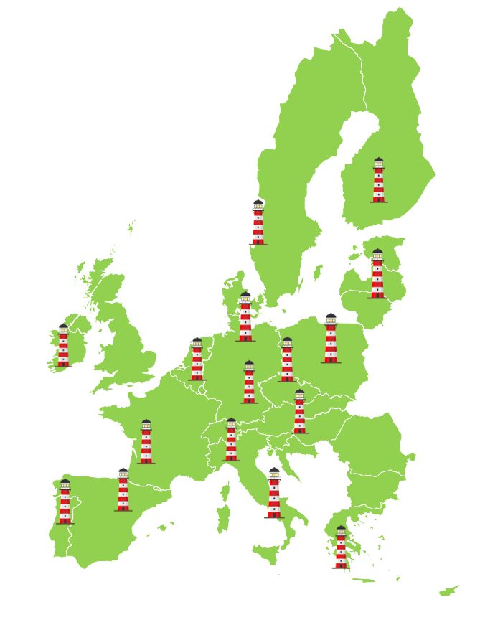
How will the mission be implemented?
1. R&I programme
3. Soil monitoring
4. Soil literacy, communication citizen engagement
2. Living labs and lighthouses
Who will act?
Data infrastructures and platforms; knowledge to support management practices, business models, technologies
Communication material, training curricula for different target groups and specialised “soil advisors”
Co-implementation of mission by: researchers, land managers, regions, businesses, policy makers, citizens and international partners
Harmonisation of indicators, measuring and reporting for soil health across Europe; contribution to European Soil Observatory
A network of real-life sites for testing, demonstrating and upscaling of solutions; due attention to balanced representation across regions
Activities under the four building blocks to address soil health and drivers of soil health

Slide 9
Living Labs and Lighthouses
Living labs are a core element of the mission
They are real-life sites in rural or urban areas in which people from various sectors and backgrounds experiment and test solutions in a co-creative manner.
Each living lab is composed of about 10-20 sites (e.g. farms, forest stands, urban green areas) working together at regional or sub-regional level.
Lighthouses are sites of exemplary performance with regards to a certain practice
They are individual sites, such as a single farm, to showcase good practices.
They are places for demonstrations, training and communication.
Network of 100 Living labs and lighthouses to be built up gradually.
Phase 2 (2025-2026)
Gradual expansion
Phase 3 (2027-)
Scaling-up
and mainstreaming
Phase 1 (2021-2024)
Induction and pilot
Living labs and lighthouses are key to accelerate the adoption of sustainable practices by users and co-developed methods adapted to the local conditions.

Slide 10
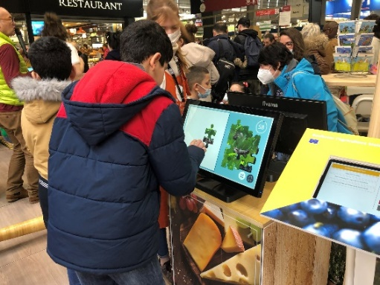
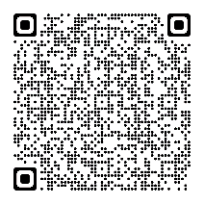
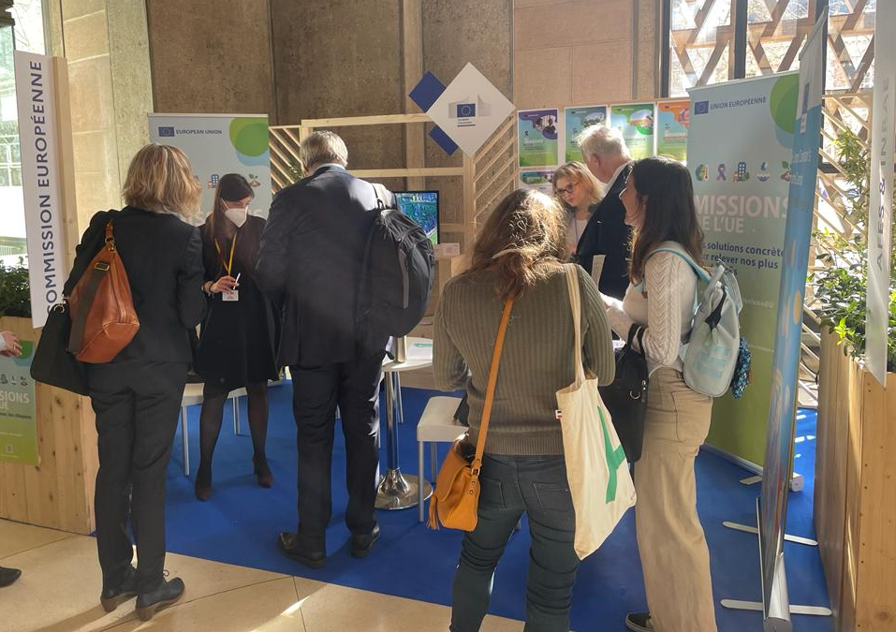
Soil literacy, communication and engagement
Foster soil education across society to bring soils closer to citizens’ values.
Engage and activate regions and municipalities to design their own strategies and actions for the protection of soils
Engage with the private sector and consumers to embed soil health in business practices
Strengthen soil health advice and improve access to training for practitioners
Support citizen-led soil stewardship and citizen science
Examples:
200+ co-creation and engagement events since September 2019
Social media campaigns including 2 campaigns #EIPAgriSoil; new one planned in 2022
2 Podcast episodes
Several articles, press releases, newsletters, 4 videos, 2 factsheets
1 Soil health results pack
Survey sent to 7000+ contacts across Europe and 2500+ contributions received
Interactive games for kids and adults, including composting training

Slide 11
Implementation of the Mission
Call for proposals under Horizon Europe
Horizon Europe Mission Work-Programme 2022 (deadline 27 September 2022)
9 topics addressing several innovation hotspots identified in the Mission Implementation Plan (Carbon farming, biodiversity, pollution)
1 Framework Partnership Agreement for Living Labs support structure
Info Days 18 May 11:15-13:30
Horizon Europe Mission Work Programme 2023
more substantial number of topics to initiate the mission
first call for Living Labs
publication of Work Programme planned for end 2022

Slide 12
Useful links
Mission A Soil Deal for Europe webpage - http://ec.europa.eu/mission-soil
Mission A Soil Deal for Europe Implementation Plan - EU Mission Soil Deal for Europe Implementation Plan (europa.eu)
Mission A Soil Deal for Europe factsheet - EU missions - Publications Office of the EU (europa.eu)
Mission A Soil Deal for Europe - Living Labs factsheet - EU mission, soil deal for Europe - Publications Office of the EU (europa.eu)
EU Missions - EU Missions in Horizon Europe | European Commission (europa.eu)
Video EU Mission “A Soil Deal for Europe” - https://youtu.be/3hPlZqwwhhM
Food for Europe podcast episode 15 Soils in danger: Europe fights back - The Food for Europe podcast | (europa.eu)
Behind the Scenes podcast episode - S02/E05: A blossoming career as a soil keeper | Behind the Scenes on Acast
On a mission to save our soils - the EU's plan to rebuild the land - Futuris episode Euronews

Slide 13
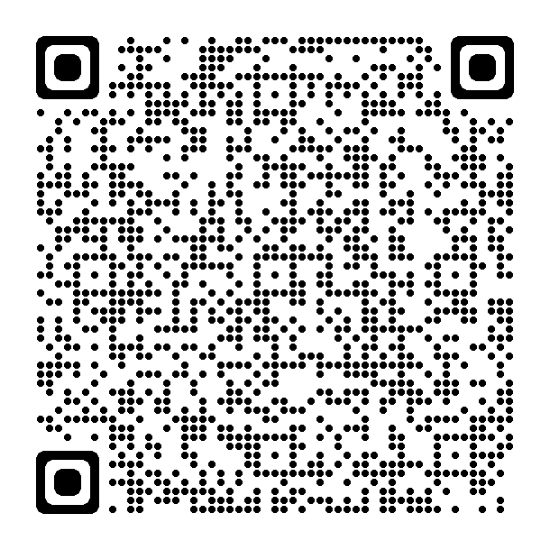
#EUmissions
#HorizonEU
#MissionSoil

