Slide 1

Thomas Bauer
federal state of
Upper Austria
4021 Linz • Kärntnerstraße 10-12
Tel.: (+43 732) 77 20-145 67
E-Mail: thomas.bauer@ooe.gv.at
Notes:
20 Minuten

Slide 2
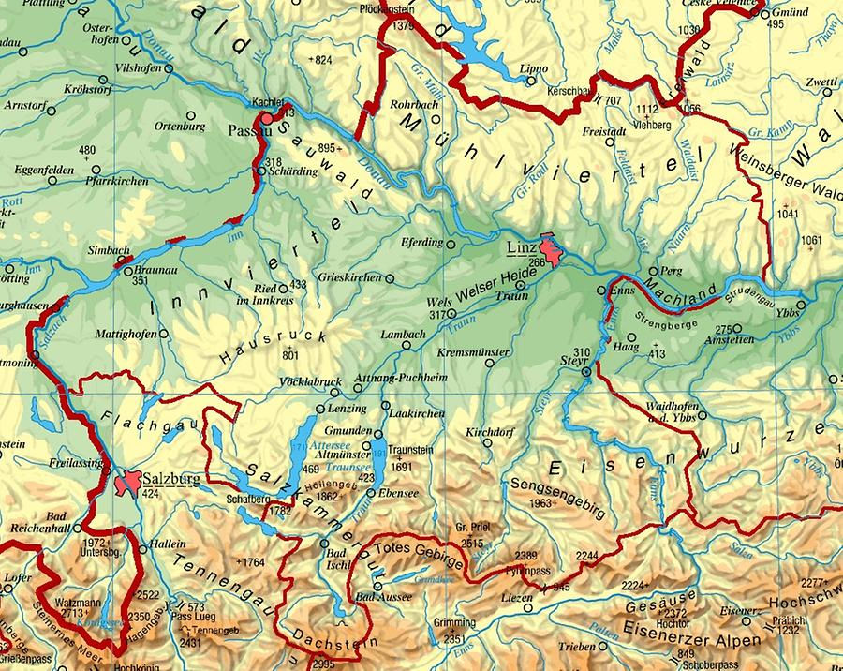
Inhapitants: appx. 1,5 Mio.
Area: appx. 11.700 km²
Elevation: 226 - 2995 m a.SL
Annual precepitation: 600 - 3000 mm
Notes:
knapp 1,5 Mio EW
ca. 600.000 ha DSR (ohne Wald, ohne Berge)

Slide 3
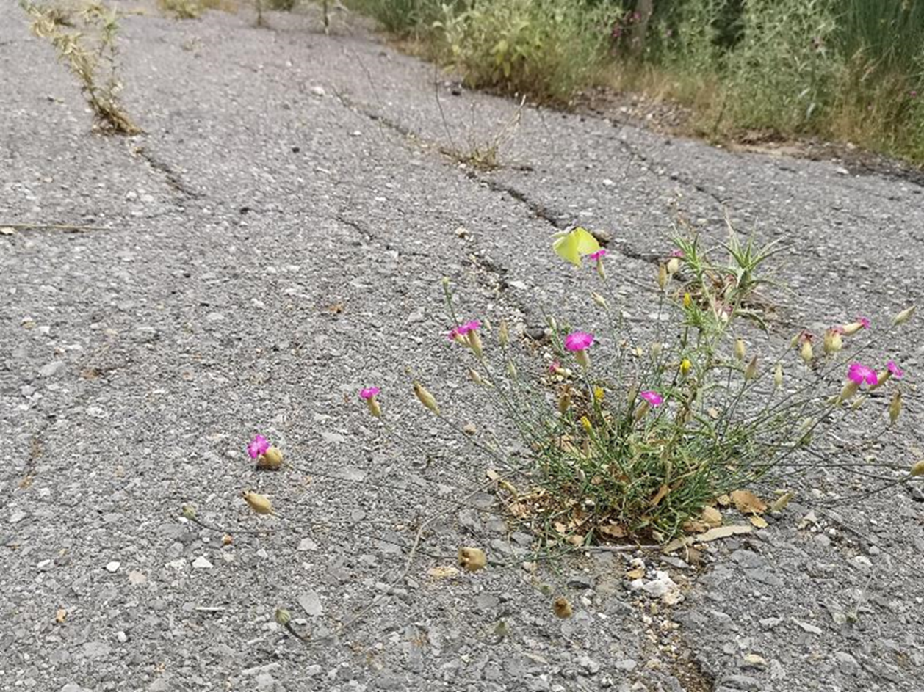

Future challenges
soil/land use
climate change adaption
sealing
→ urban heat island
→ biodiversity loss
→ change in water household

Slide 4
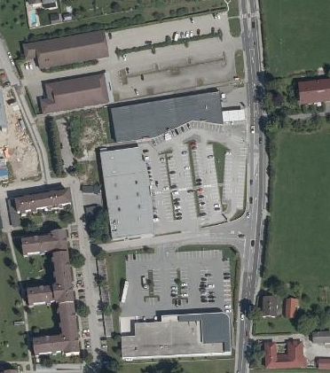
How it began (2021)
Funding for the planning and preparation of an greening and unsealing concept for this area
(app. 40.000 m²)

Slide 5
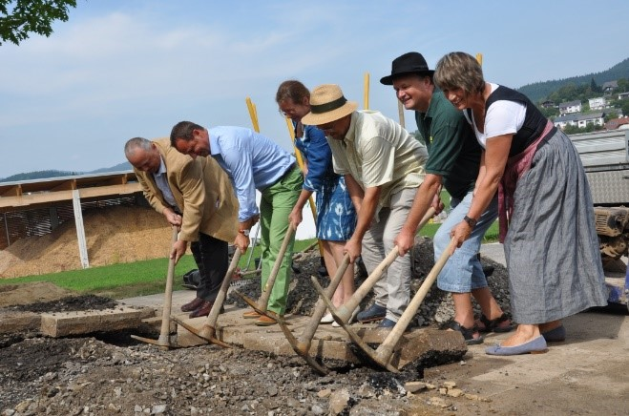
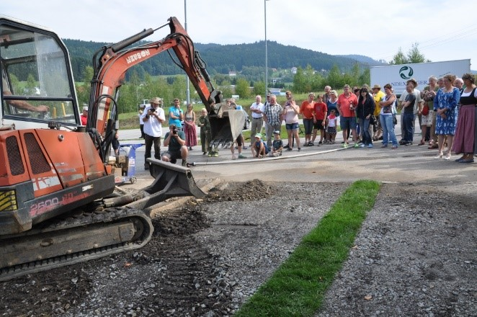
Political idea:
© Bodenbündnis Oberösterreich
"Asphalt ackern in Haslach"
ploughing asphalt

Slide 6



Background information
first run
open from oct. 2022 to oct. 2023
focus on surface discharge reduction/ increase infiltration by unsealing
only for municipalities

Slide 7

Challenge
Permission for the discharge or percolation of "filtered, cleaned" precipitation water on sealed surfaces (ex. parking lots)
definition how these surfaces should be constructed
and how surface water should be cleaned before discharge in rivers or percolation to the underground
... need to adapt the actual permissions or to recieve new ones
state of the technology and official guidelines

Slide 8
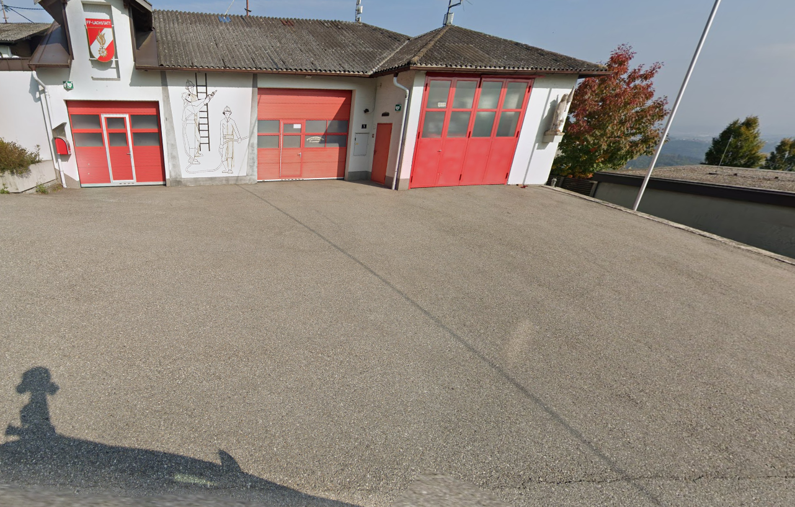
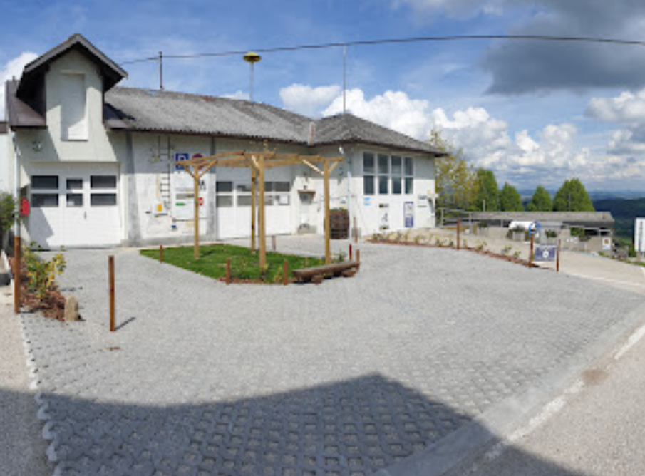
(worst) example 1st call

Slide 9

Lessons learned 2nd call (actual one) 1
fund for:
unsealing of "one piece" with an area >100 m²
open for:
owners or authorized persons of the area
measures funded:
unsealing (complete) with the goal to "remake" a typical soil for this site
unsealing (partly) – goal: partly paved surfaces (gravel lawn, grass paved blocks,...) to improve the percolation on site
measures for "site-typical" greenings

Slide 10

Lessons learned 2nd call (actual one) 2
Additional funding rules:
submission of the application before beginning of any building activities
no sealing the next 10 years
time to finalize the construction <1 year
no danger to soil or (ground)water – permission for percolation or discharge
proof/certificate for the appropriate waste removal
€
30 €/m² max. of 75.000 € per project and max. 70% of the overall investment costs per project
if the community where the measure is done, is part of European Land and Soil Alliance 40 €/m² max. of 80.000 €
period of funding: - 31. Dec. 2025

Slide 11
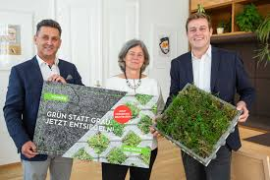
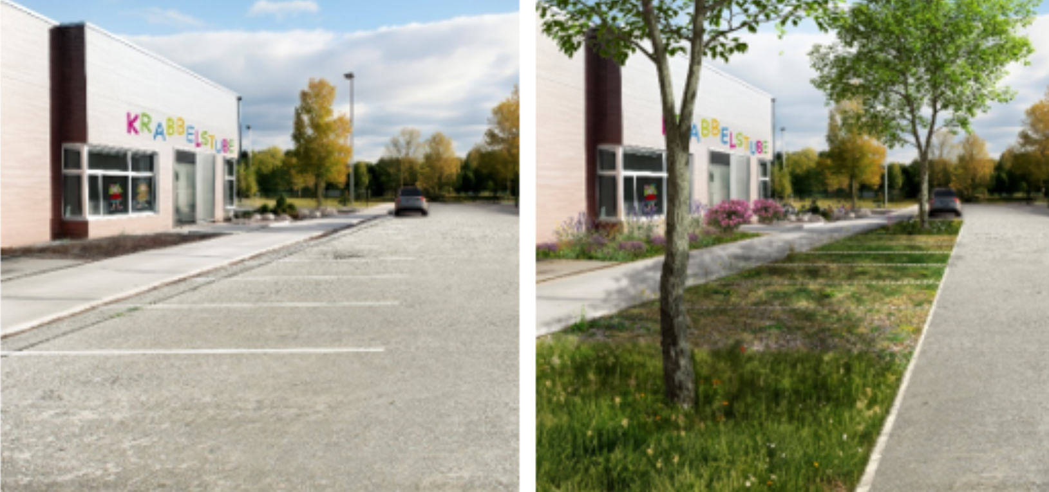
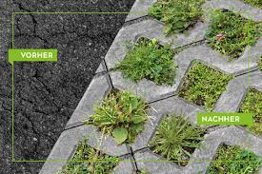
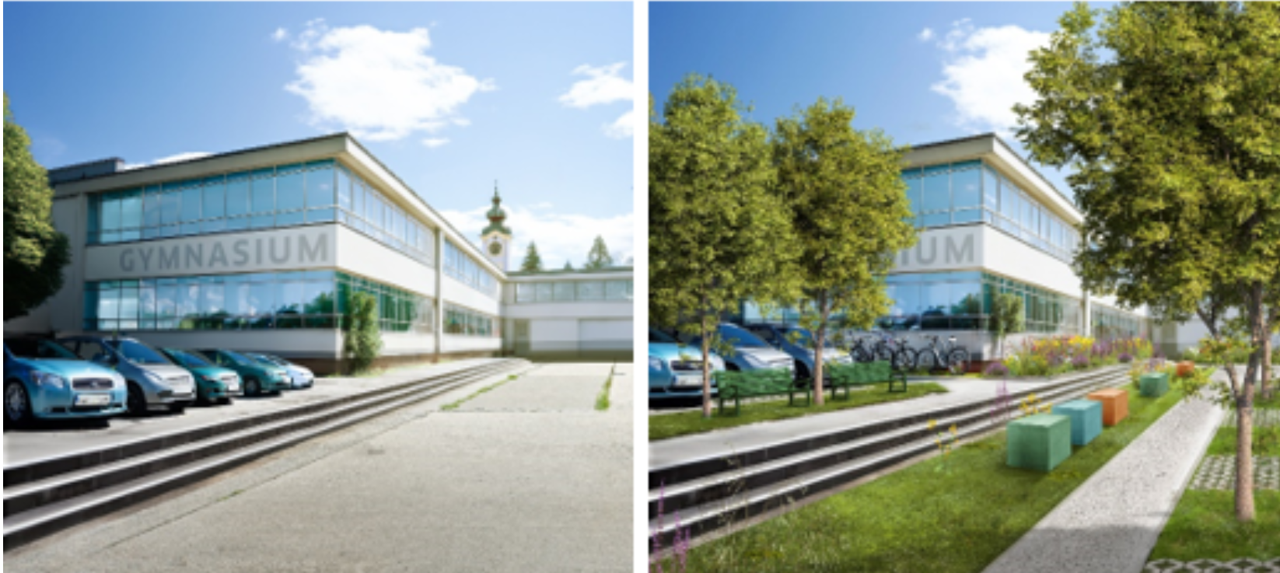
Promotion

Slide 12
Submissions since 2022
requests/fundamental questions: ~2-4 per week (phone, email)
number of submitted projects: 37
denied projects: 4
accepted projects 33
finalized projects 5 (60.180€ 1.523 m²) in 2022 and 2023
Projects are highly heterogenous:
area from 100 m² to >1.000 m²
kind of "unsealing" – complete or partly
private or public

Slide 13
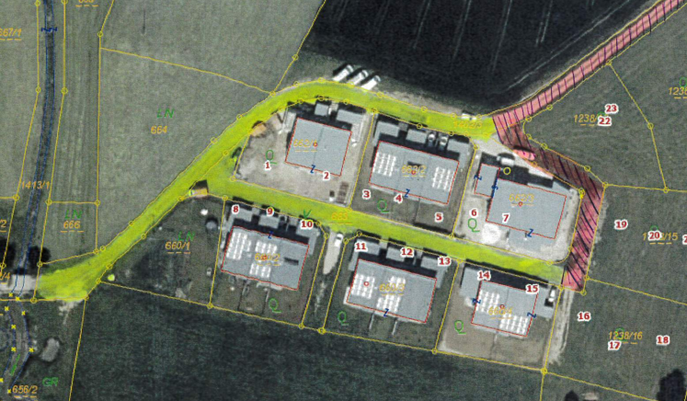
FAQs
100m² in one piece ?
partly paved surfaces – examples ?
Any specifications about drainage ?
Is there any fund for not sealing ?

Slide 14
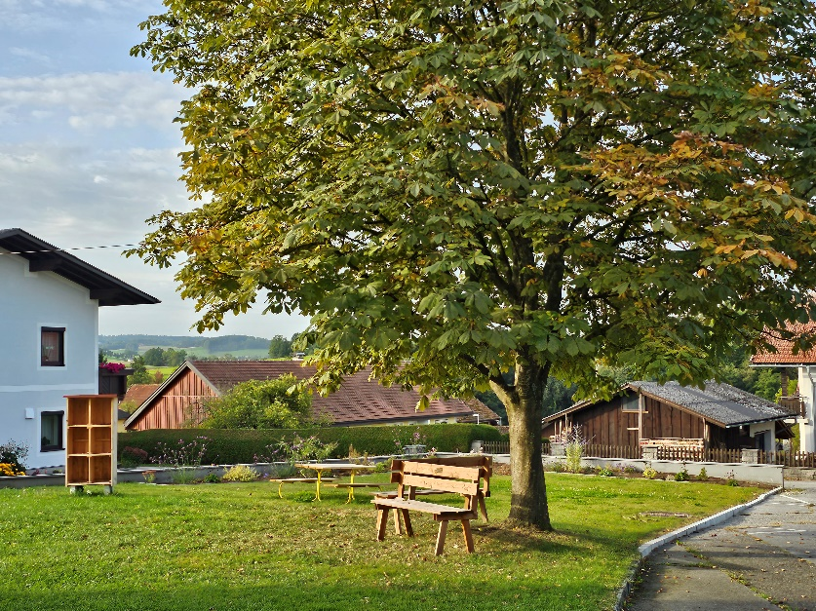
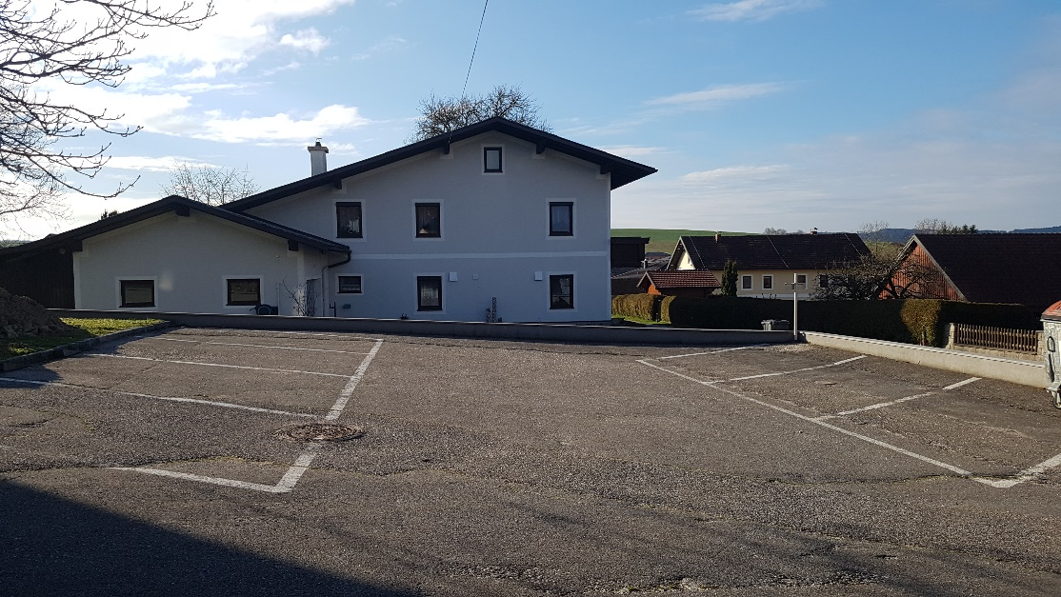
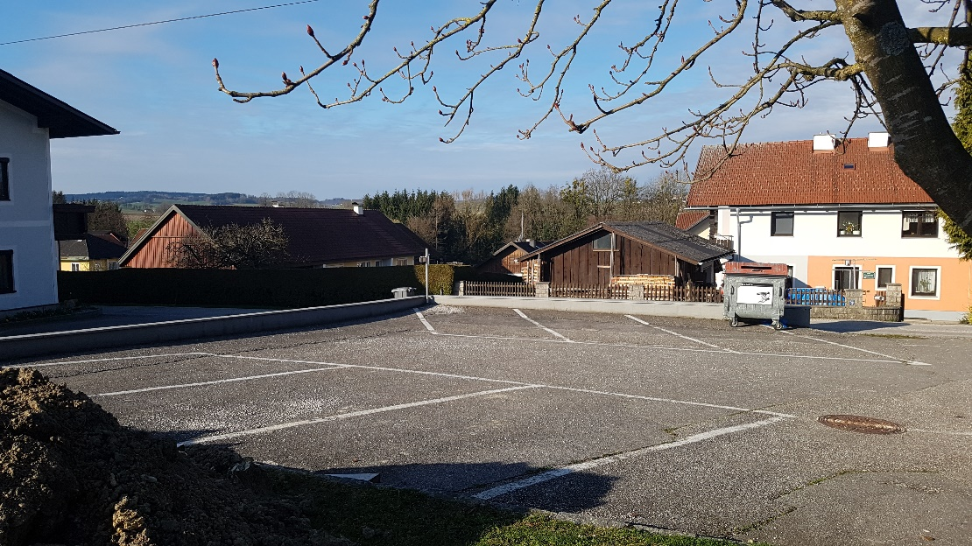
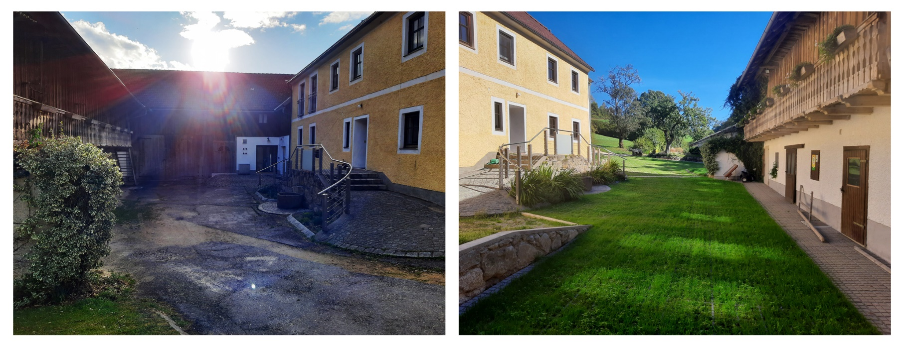
Examples

Slide 15
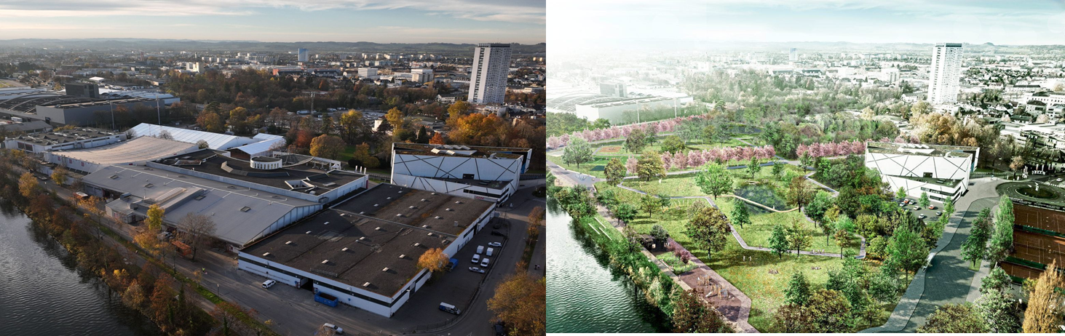
Plans, Ideas, ...

Slide 16
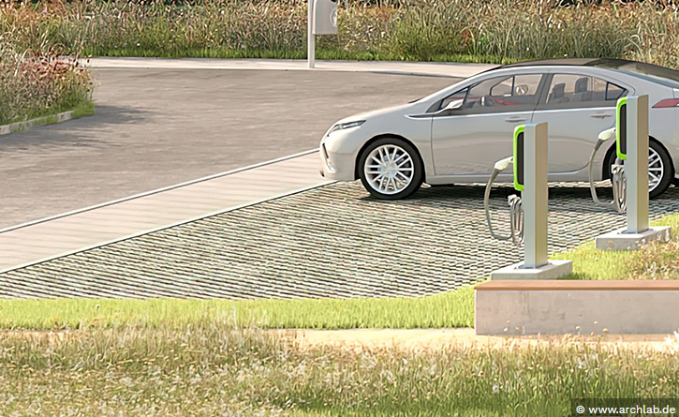
further funds in Upper Austria
Fund for e-charging stations includes some extra money for part-paved parking lots
City of Linz; fund for greening and unsealing of "private owned" courtyards

Slide 17
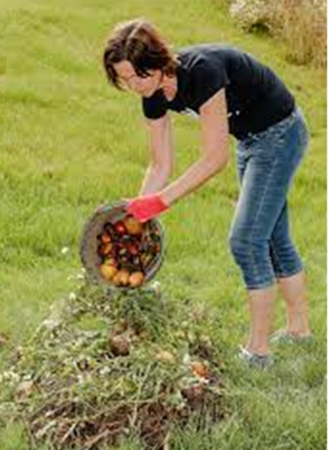
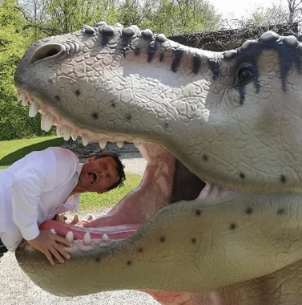



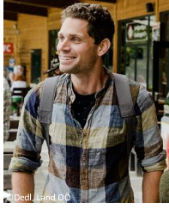
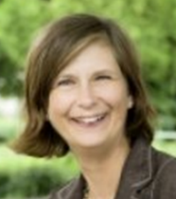
Activities.... besides funding desealing measures
Soil protection as legal basis
official experts for soil protection
consultations for soil protection
several funds
soil awareness raising
current team
Sandra Urban
Marina Aigner
former team:
Hermann Miesbauer
Renate Leitinger

