Slide 1
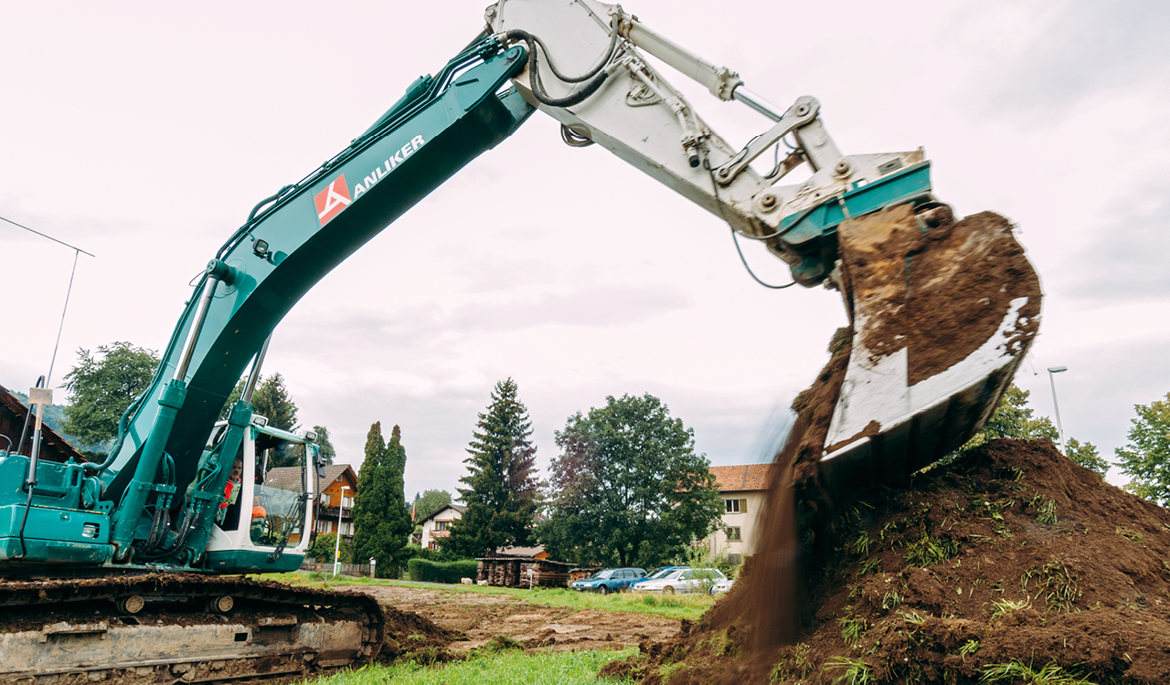
Flächen:sparen – soil saving strategies in Switzerland
Sven-Erik Rabe | ETH Zurich | incolab

Slide 2
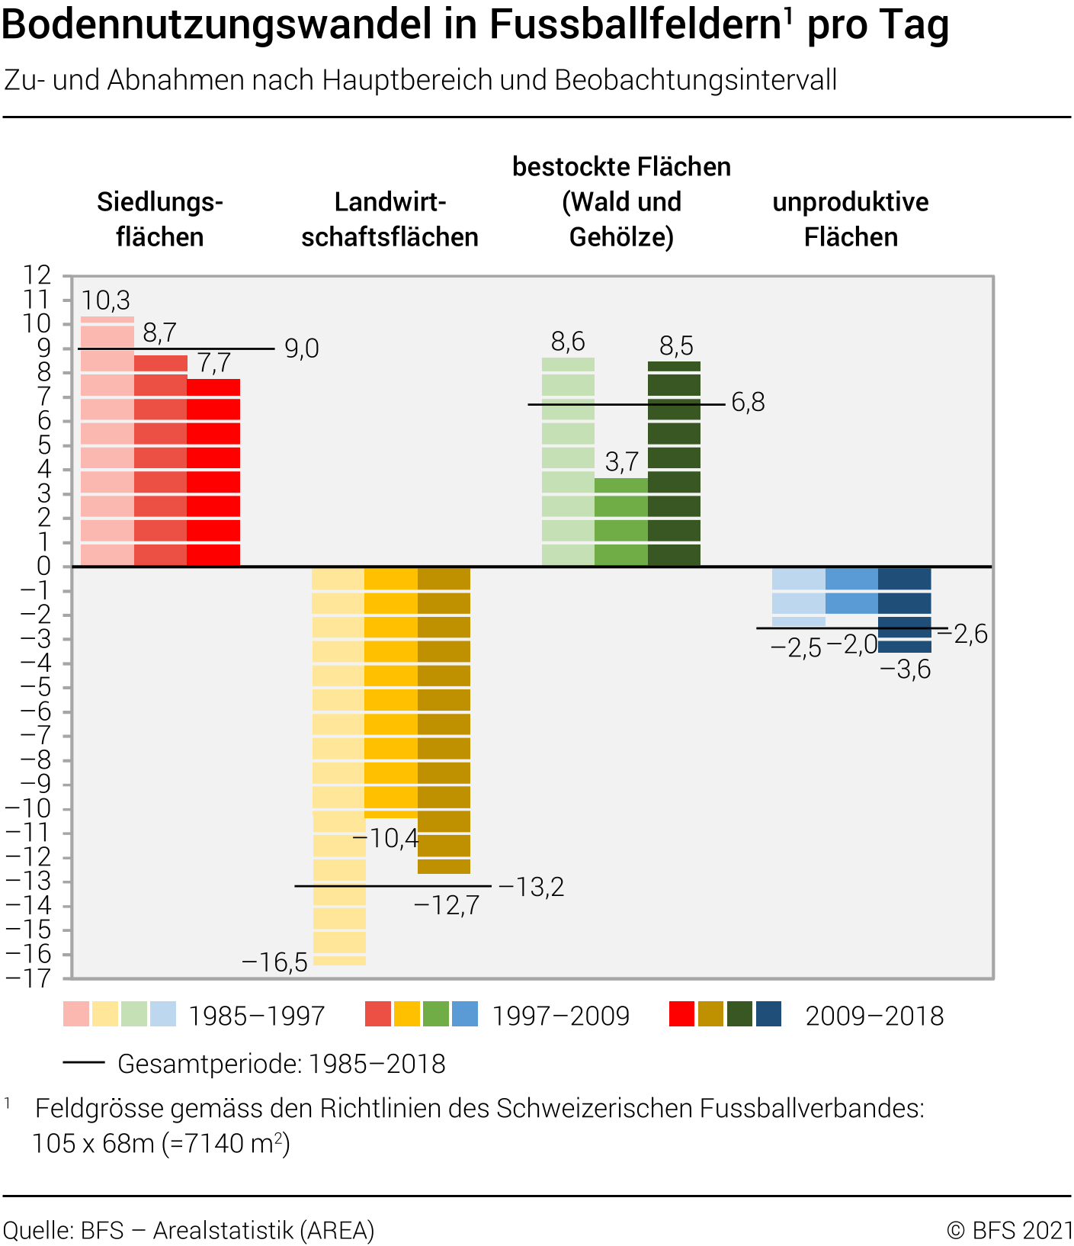
Landuse change

Slide 3
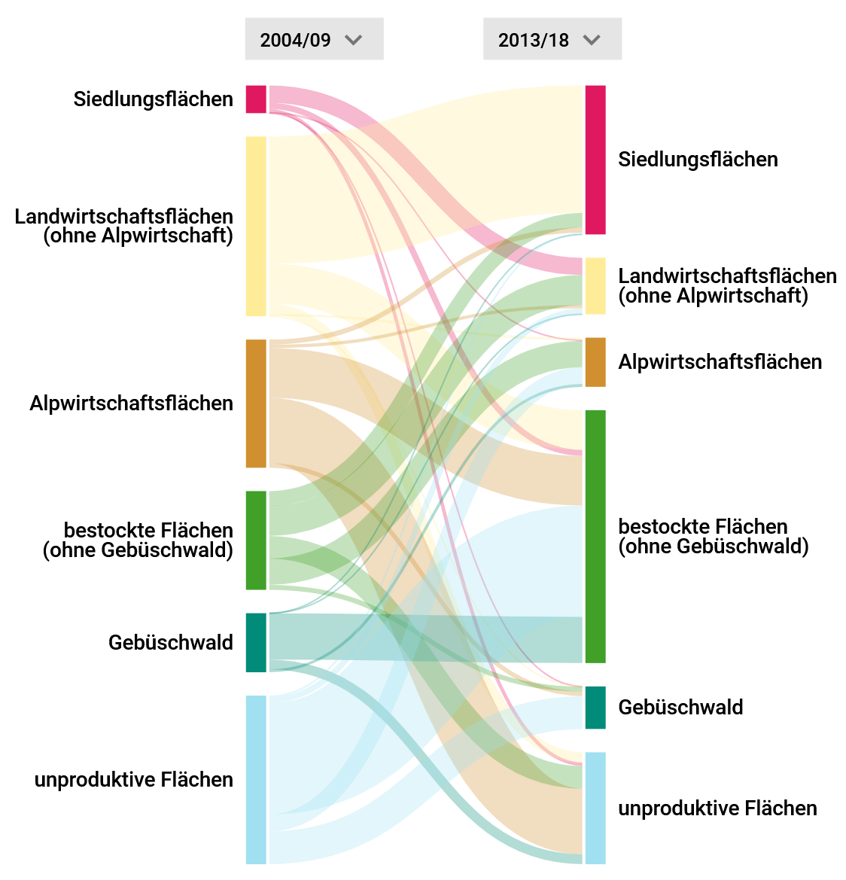
Settlement growth
Quelle: BFS, 2021

Slide 4
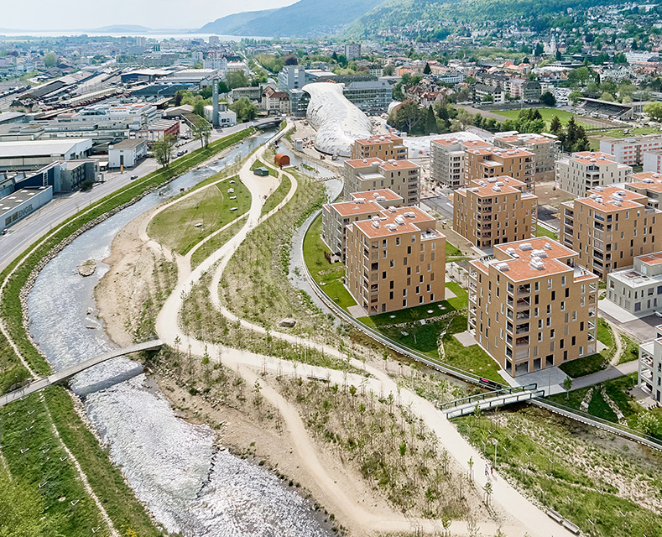
Legal requirements
Inner development
Filling gaps between buildings
Densification of settlements
Converting brownfield sites
Mobilize construction land
Reduction of oversized building zones

Slide 5
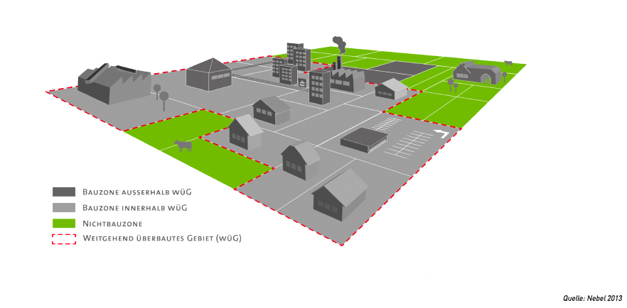
Options for settlement development

Slide 6
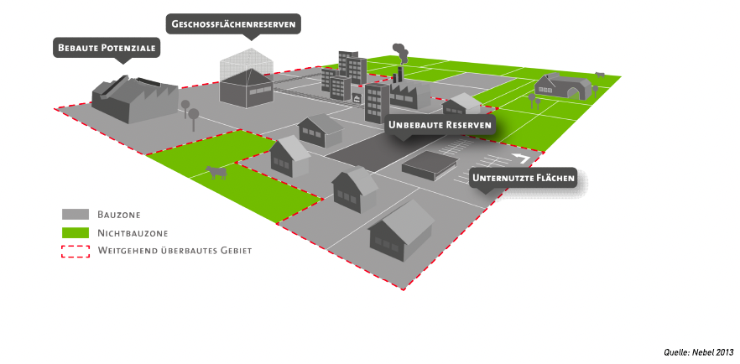
Options for settlement development

Slide 7
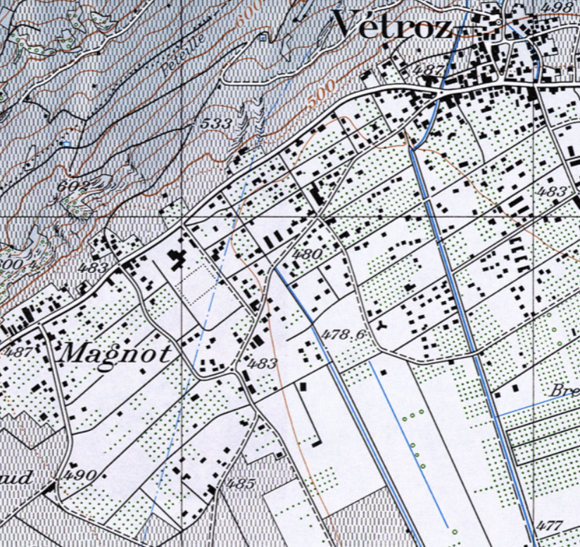
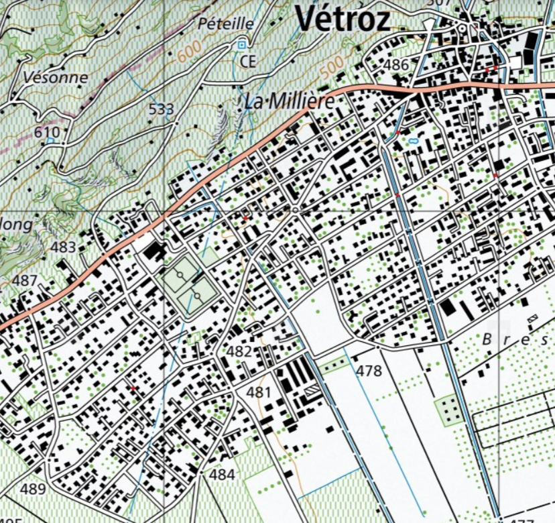
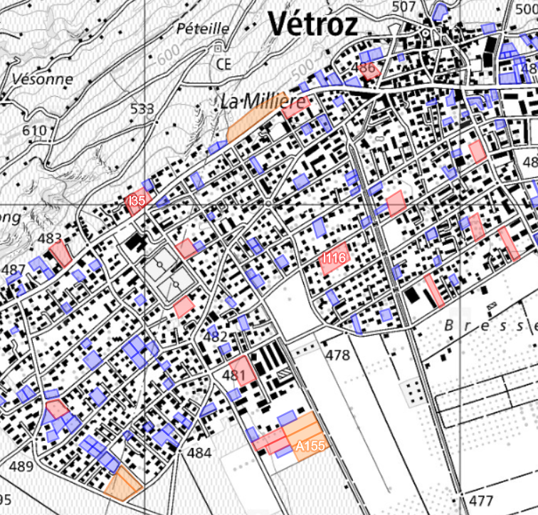
Options for settlement development
1980
2020
© Kartengrundlagen: swisstopo

Slide 8
Challenges
There are several challenges at the municipal level:
Scarcity of resources and lack of expertise.
Conflict of interest between local politics and active land policy
Planning autonomy and space for interpretation
Communication of abstract and complex issues
Successful local planning requires stewardship

Slide 9
Building outside the building zone
Datengrundlage: ARE, 2021

Slide 10
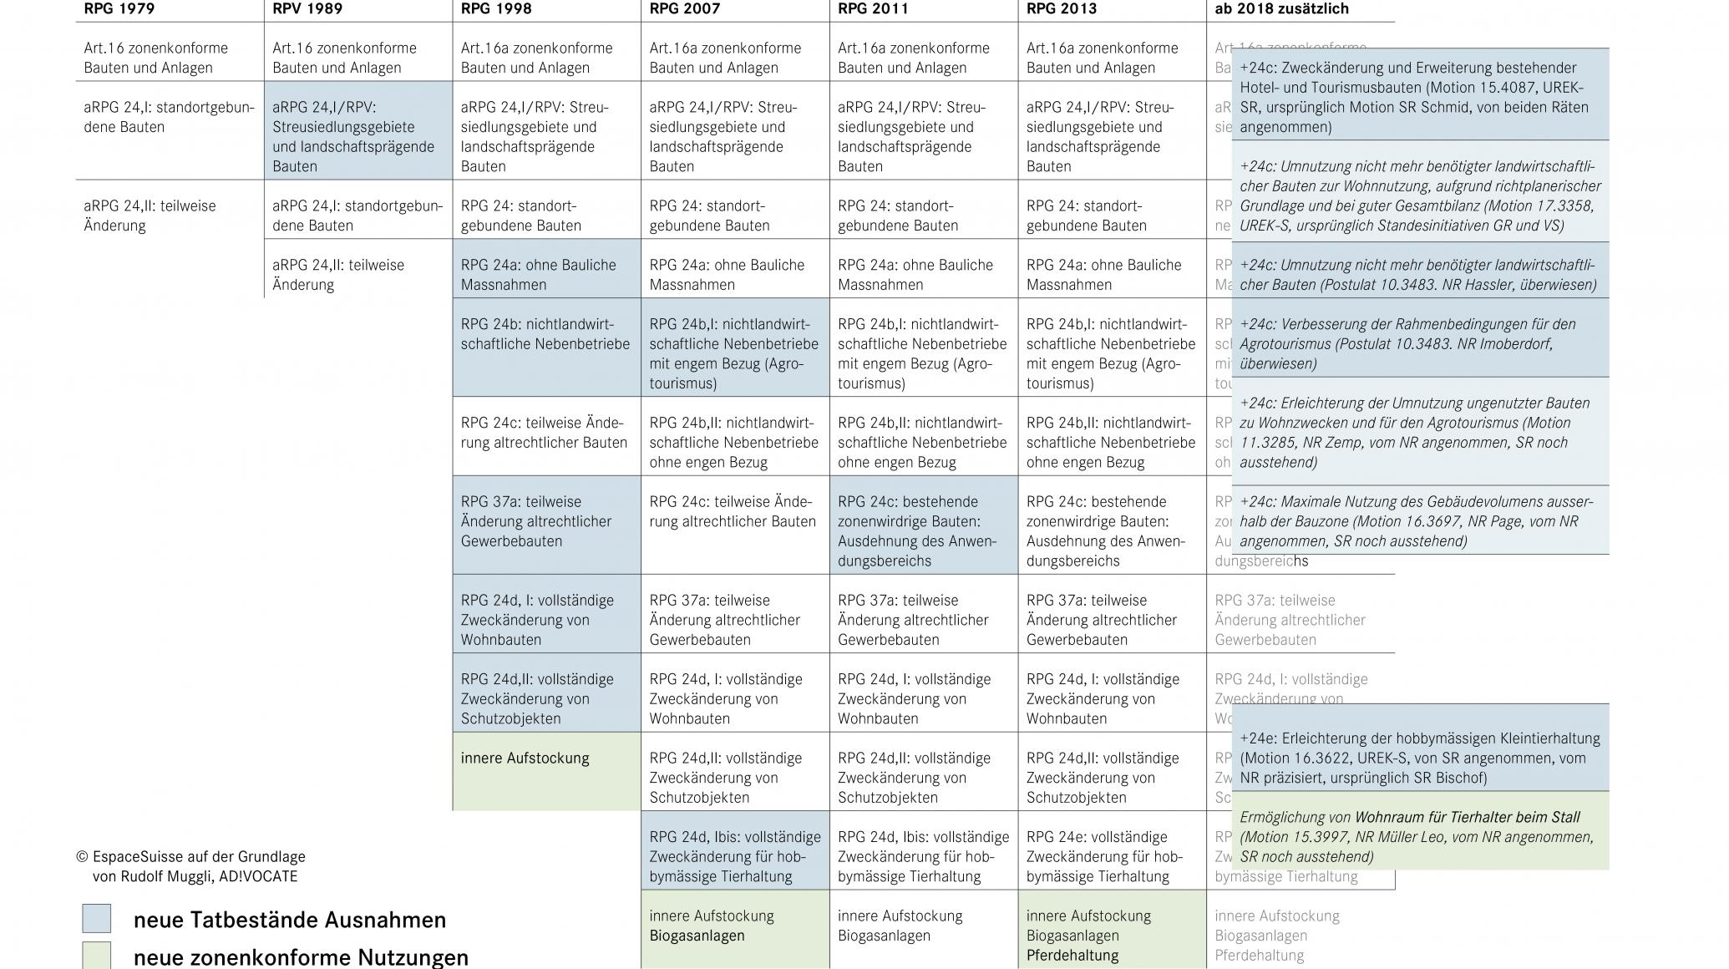
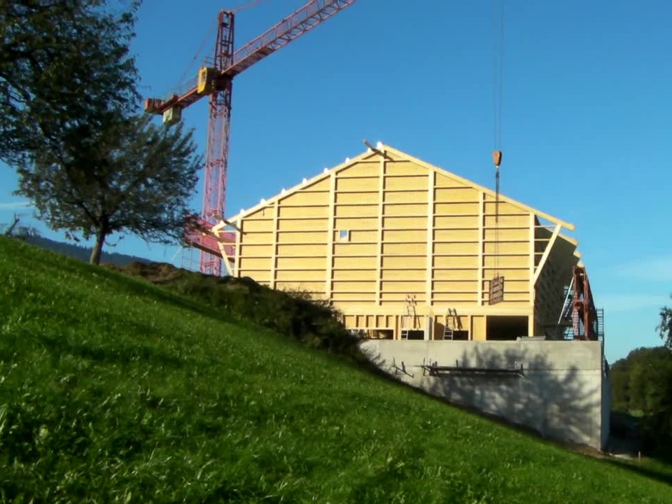
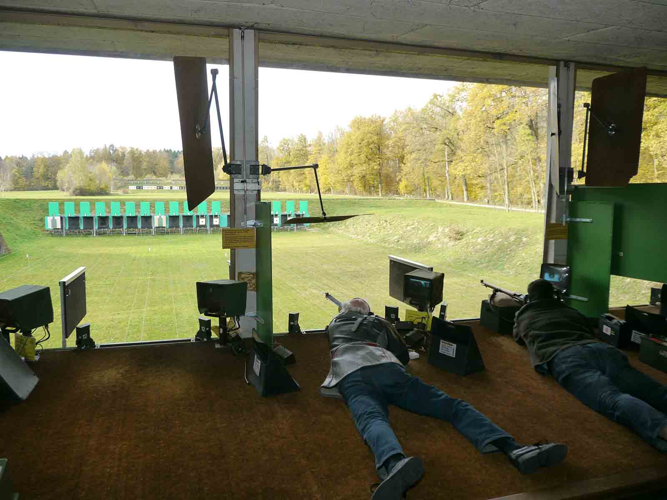
Building outside the
building zone

Slide 11
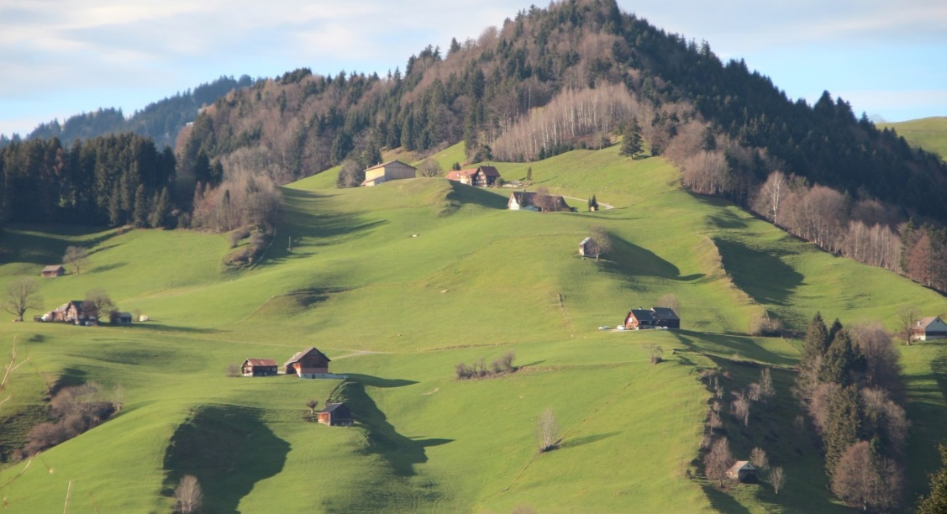
Building outside the building zone

Slide 12
